Slide 1
Header
Healthy Eating
Sleeping Habits
Exercise
Other Topics
Text
Text
Text
Text
Text
Text
Text

Slide 2
Header
Healthy Eating
Text Text Text Text Text Text Text Text Text Text Text Text Text Text Text Text Text Text Text Text Text Text Text Text Text Text Text Text Text Text Text Text Text
Image
Text
Text Text Text Text Text Text Text Text Text Text Text Text Text
Text Text Text Text Text Text Text Text Text
Text Text Text Text Text Text Text Text Text Text Text Text
Text Text Text Text Text Text Text Text Text Text Text
Text
Text
Text
Text
Text
Text
Text

Slide 3
Header
Sleeping Habits
Text Text Text Text Text Text Text Text Text Text Text Text Text Text Text Text Text Text Text Text Text Text Text Text Text Text Text Text Text Text Text Text Text
Image
Text
Text Text Text Text Text Text Text Text Text Text Text Text Text
Text Text Text Text Text Text Text Text Text
Text Text Text Text Text Text Text Text Text Text Text Text
Text Text Text Text Text Text Text Text Text Text Text
Text
Text
Text
Text
Text
Text
Text

Slide 4
Header
Exercise
Text Text Text Text Text Text Text Text Text Text Text Text Text Text Text Text Text Text Text Text Text Text Text Text Text Text Text Text Text Text Text Text Text
Image
Text
Text Text Text Text Text Text Text Text Text Text Text Text Text
Text Text Text Text Text Text Text Text Text
Text Text Text Text Text Text Text Text Text Text Text Text
Text Text Text Text Text Text Text Text Text Text Text
Text
Text
Text
Text
Text
Text
Text

Slide 5
Header
Other Topics
Topic 1
Topic 2
Topic 3
Text
Text
Text
Text
Text
Text
Text

Slide 6
Header
Gallery
Image
Image description
Text
Text
Text
Text
Text
Text
Text

Slide 7
Header
Videos
Text
Text
Text
Text
Text
Text
Text

Slide 8
Header
Contact
Name:
Email Address:
Message:
Submit
Text
Text
Text
Text
Text
Text
Text

Slide 10
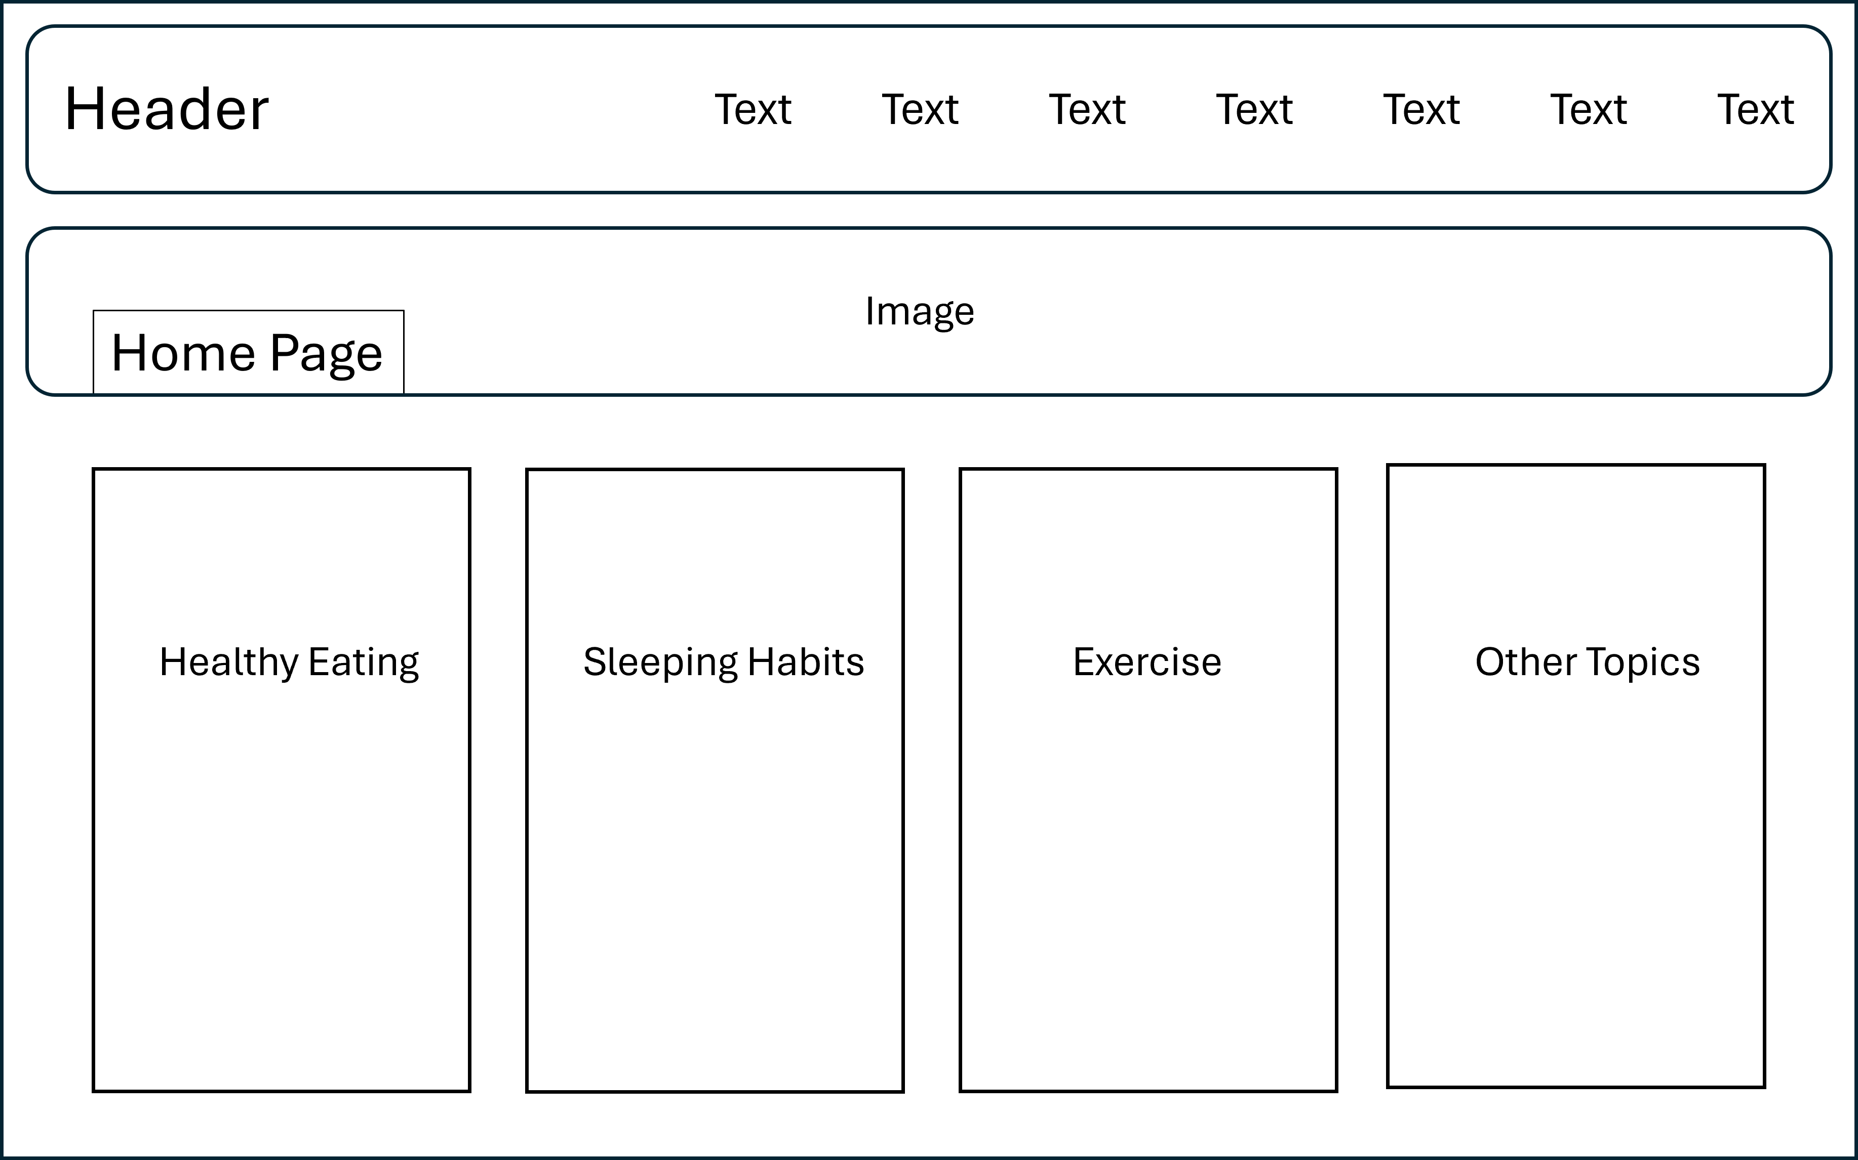

Slide 11
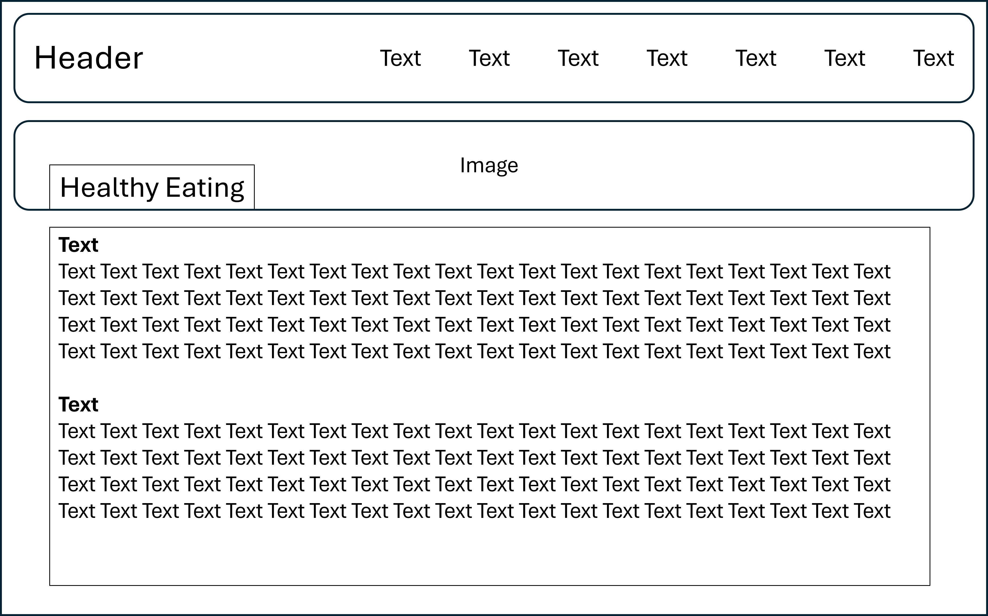

Slide 12


Slide 13
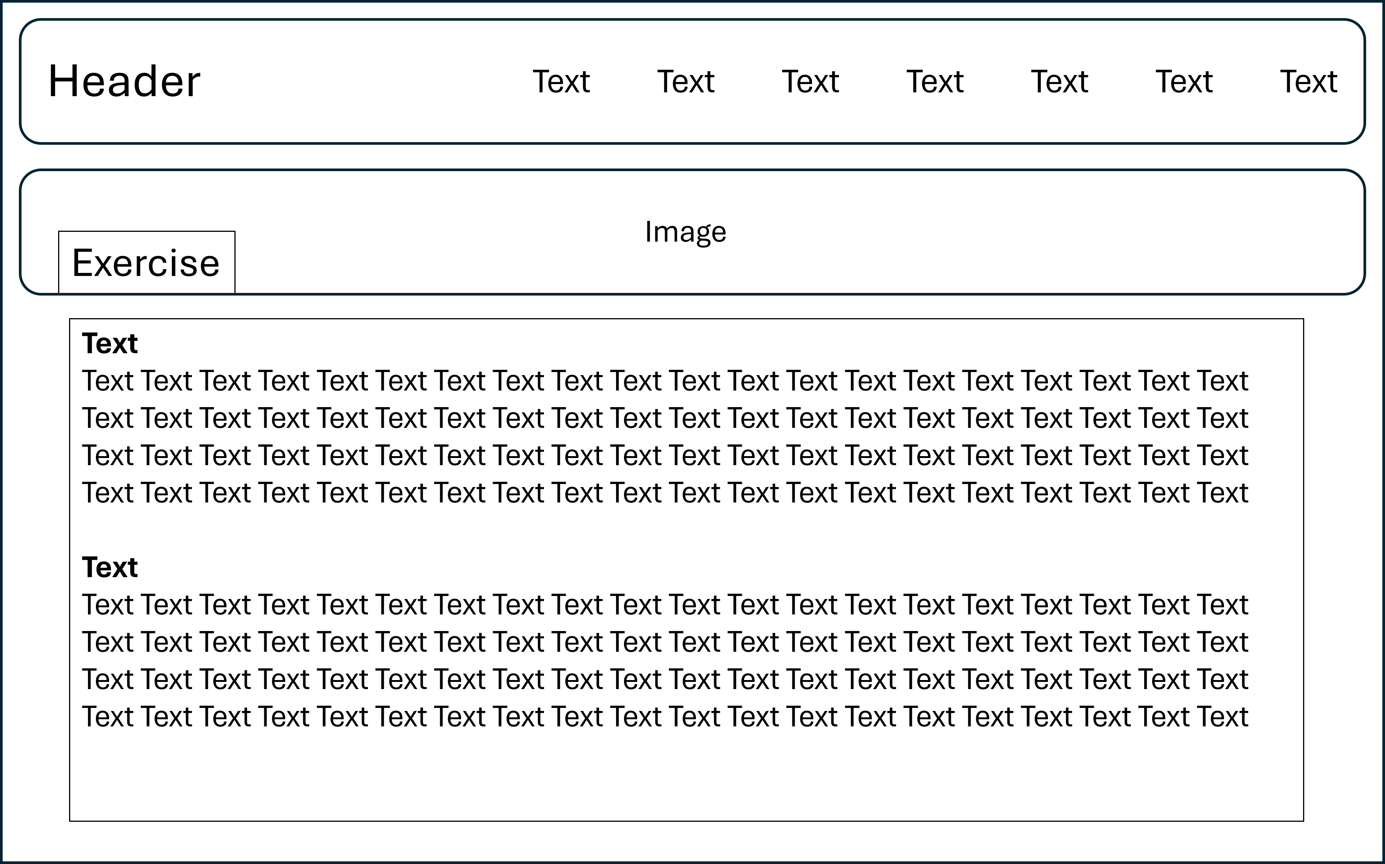

Slide 14
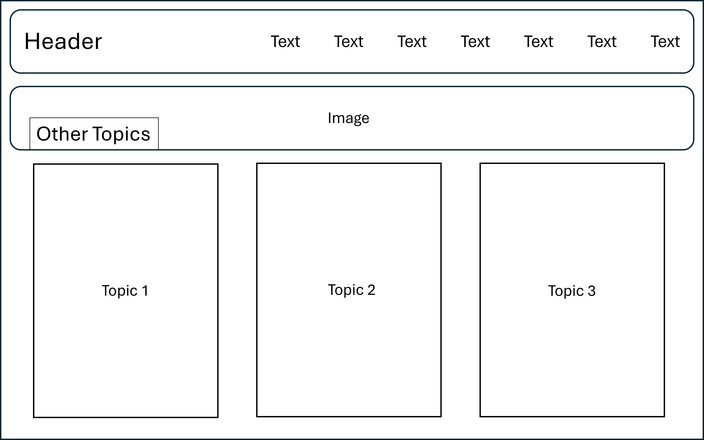

Slide 15
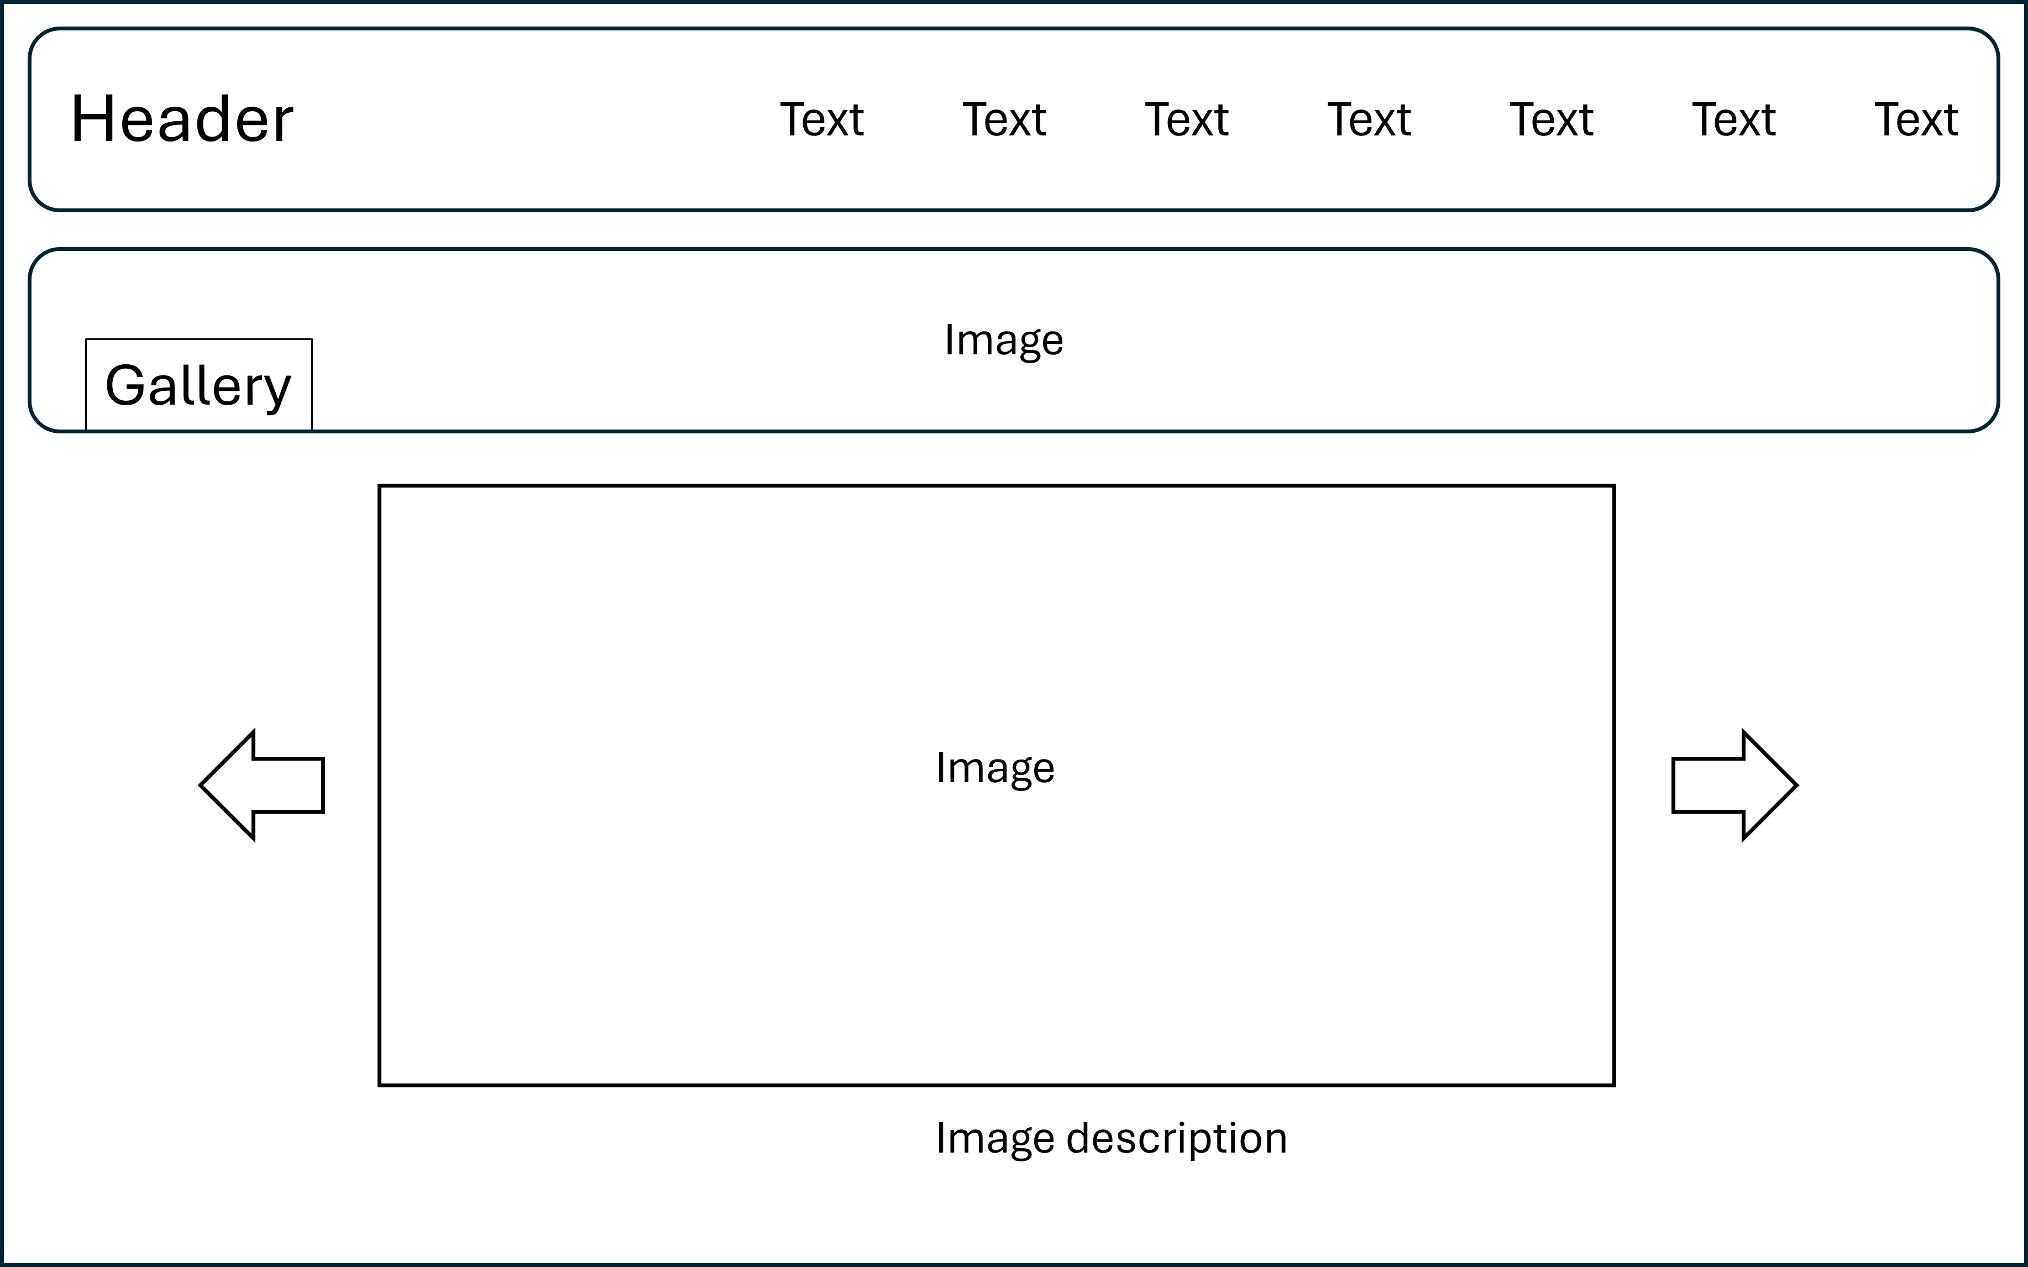

Slide 16
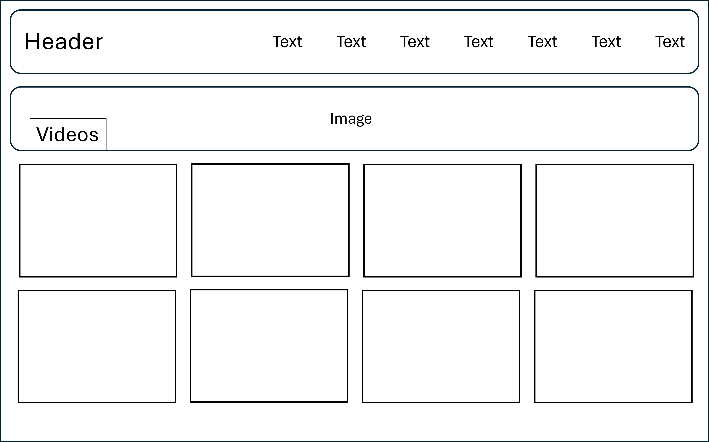

Slide 17
